Slide 1

HEART SHAPED BOX: An Exploration and Harnessing of Data on Cardiovascular Disease (CVD)
Collaborators:
Stephen Milton
Anthony Elbers
Divya Gururajan Sumangala
Brett Wallis
Nalishebo Meebelo
Notes:
Shebo

Slide 2

Project Motivation
To identify relationships of different variables in the context of CVD
Questions:
Which gender (male or female) is more likely to have CVD?
Does age influence the potential risk factor of CVD?
What type of lifestyle variables can increase the potential of contracting CVD?
Summary of findings:
CVD does not have a direct correlation with Gender.
As age advances, prevalence of CVD is more evident
CVD has a direct correlation with Cholesterol, Blood Pressure, BMI, Physical Activity and Glucose
Notes:
Shebo

Slide 3


Questions and Data
The group selected the medical field as an area of study for this project from the following list:
Medical, Finance, Health, Sport, NASA
Source a Large Dataset with multiple variables relating to CVD
Searched Open Source Data
Medical Data
Medical Studies
Features of the Dataset – factual, results of med. examination, sourced from patients
Surveyed API Data from WHO, ABS, AMA, DMC.
We did not find the data we required
We were unable to interpret the data due to lack of knowledge on medical terminology
Found suitable CSV files at Kaggle.com
Notes:
Shebo

Slide 4
Data Cleanup & Exploration Process
Exploration and cleanup process
3 CSV files downloaded
Converted CSV using Pandas Dataframe
No null values found in the Dataset
Calculated and created BMI and Blood Pressure Columns
Challenges:
Tried to unite 2 raw Datasets with different headers and observations
Smaller data set had numerous null values. Once removed there was not enough data to make a significant impact on the larger dataset.
Inability to interpret available data from APIs
Insights:
Discovered majority of data contained dichotomous variables
Developed Logistic Regression to establish correlation between variables
Developed Contingency Tables
Developed a Predictive Model
Solutions:
Resolved to use one Dataset due to mismatch in headers and duplicate data
Opted not to include APIs in the project
Notes:
Brett

Slide 5

Data Analysis
Installed the necessary libraries
pandas, matplotlib, scipy, statsmodel, sklearn, numpy, seaborn
Developed relevant Dataframes
Due to binary nature of data, used logit regression to enable further analysis
Developed Contingency Tables and Graphs (bar, pie, hist)
Predictive Model
To predict potential risk factors leading to CVD
Notes:
Brett

Slide 6
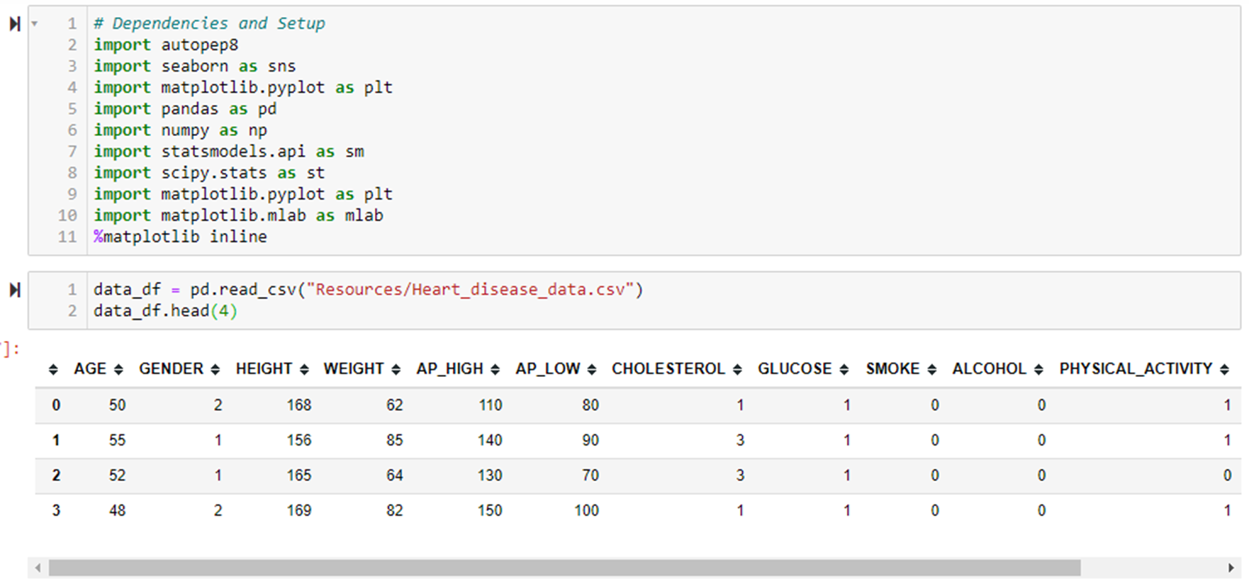
Data Analysis: Dependencies and first pandas data frame.
Notes:
Divya

Slide 7
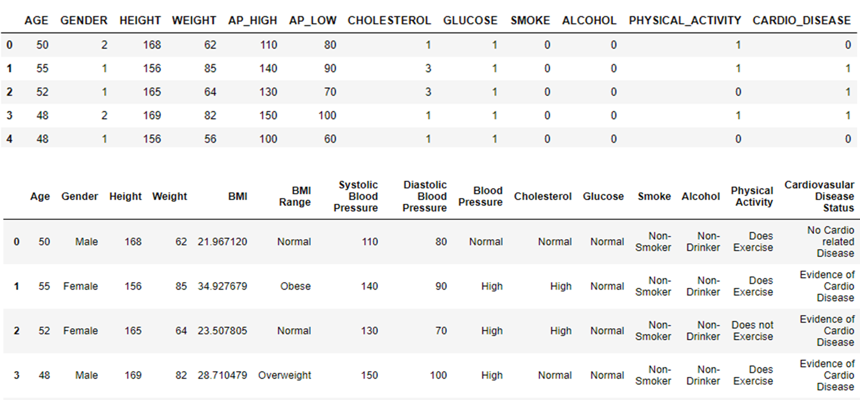
Data Analysis
Original Data Frame (‘data_df’)
Clean Data Frame (‘values_entered’)
Notes:
Divya

Slide 8
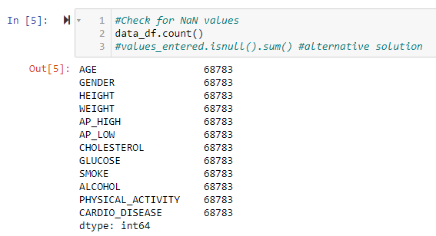
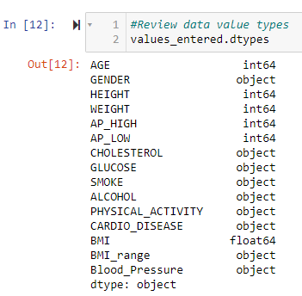
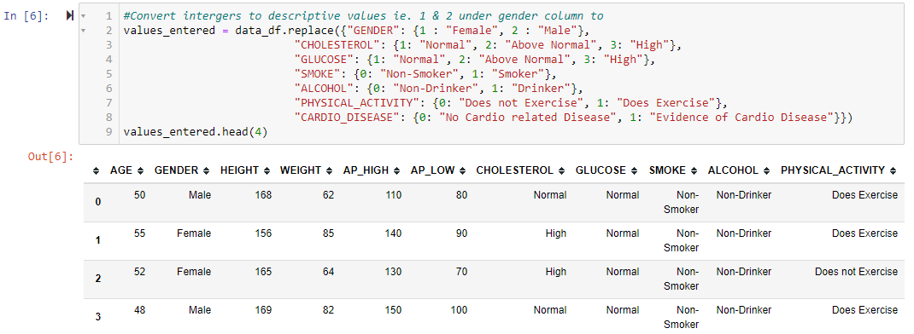
Data Analysis: Clean and review data variables.
Notes:
Divya

Slide 9
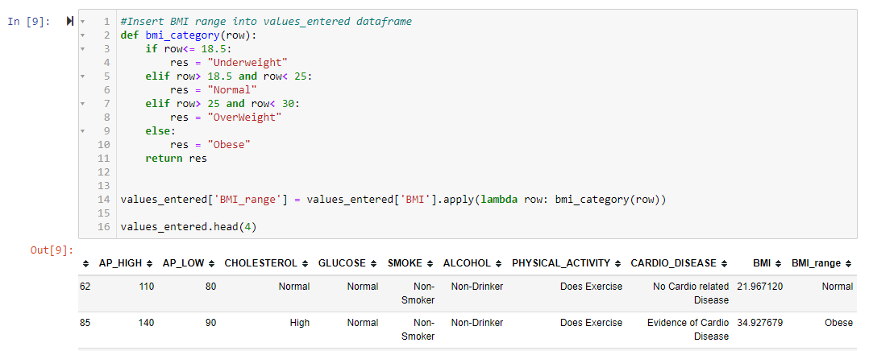
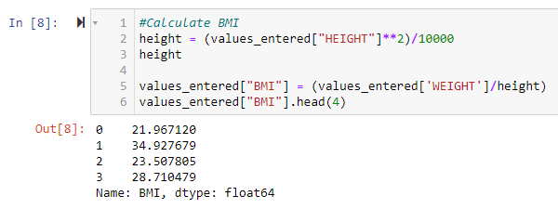
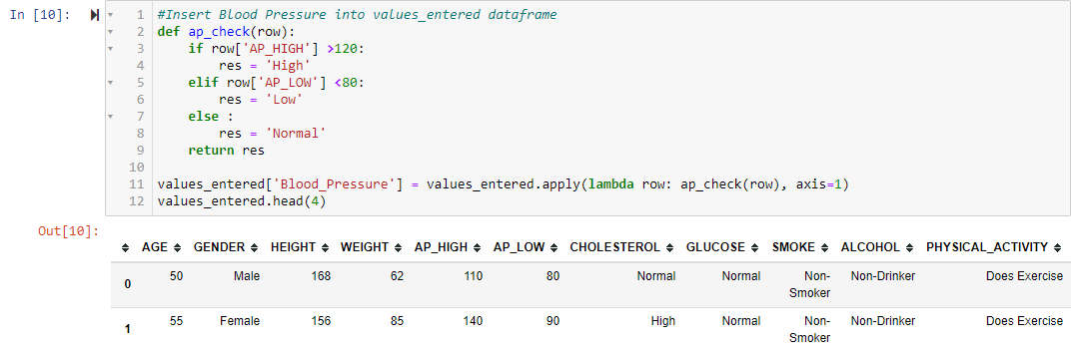
Data Analysis: Insert BMI and Blood Pressure Range
Notes:
Divya

Slide 10
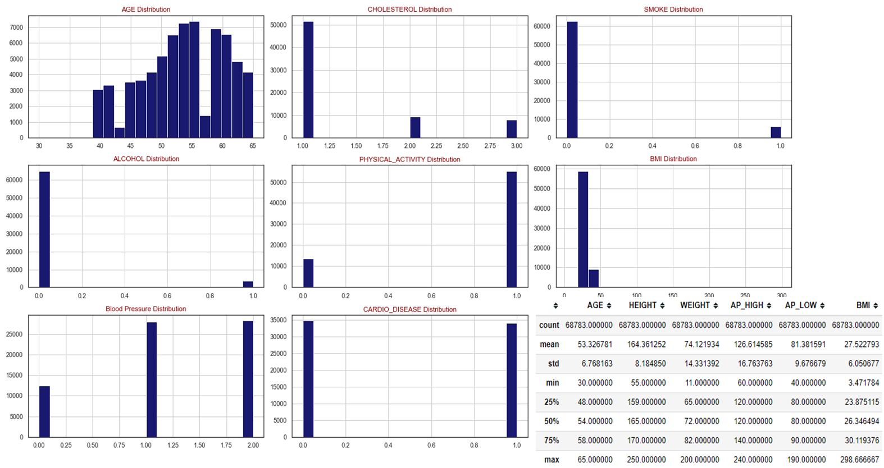
Data Analysis
Notes:
Divya

Slide 11
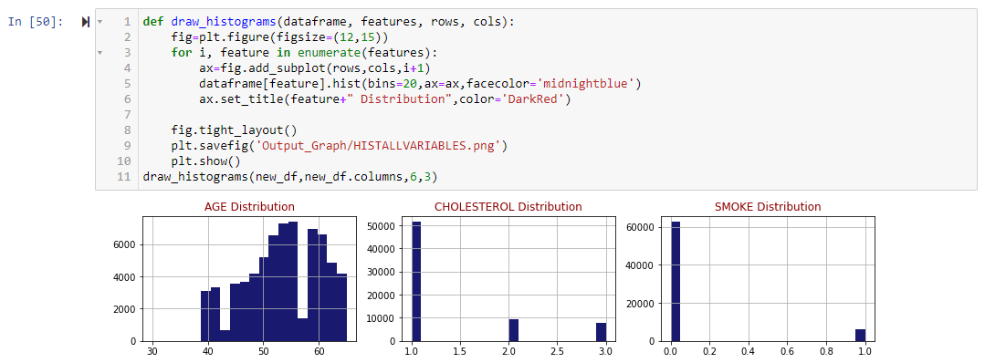
Data Analysis: Create Histograms with seaborn
Notes:
Divya

Slide 12
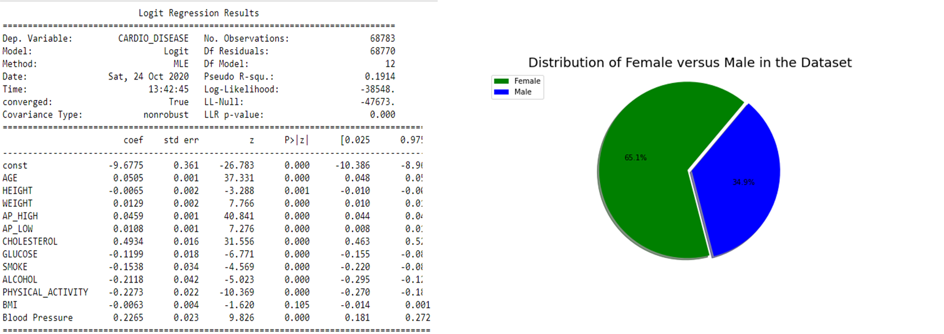

Data Analysis
Notes:
Divya

Slide 13
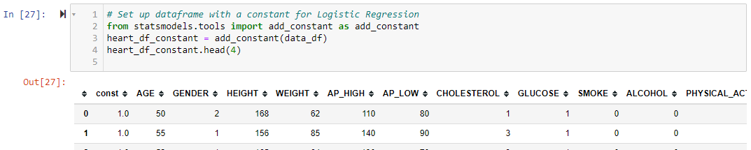
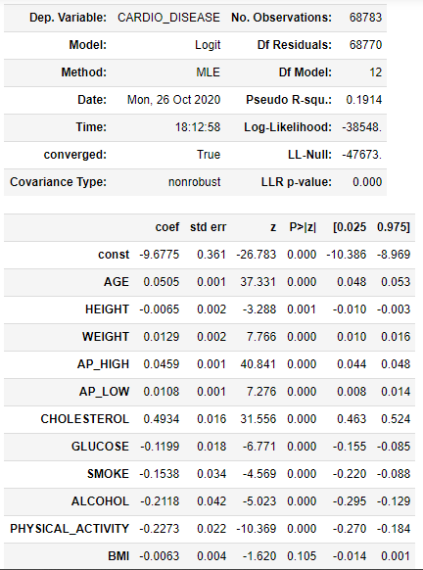
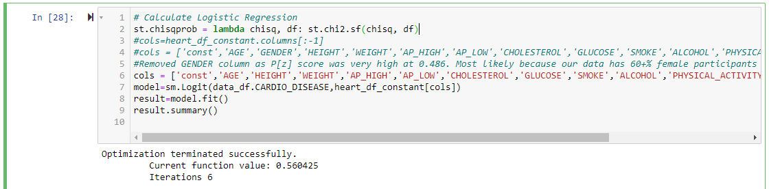
Data Analysis: Logistic Regression to find correlations with Chi2 (Chi Square)
Notes:
Divya

Slide 14
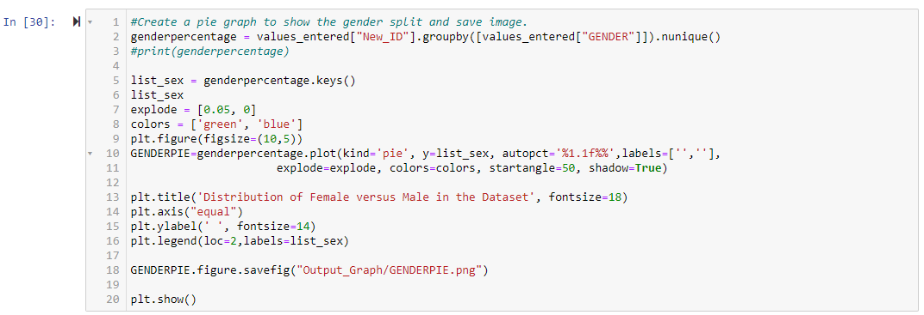
Data Analysis: Create pie graph for gender split
Notes:
Divya

Slide 15
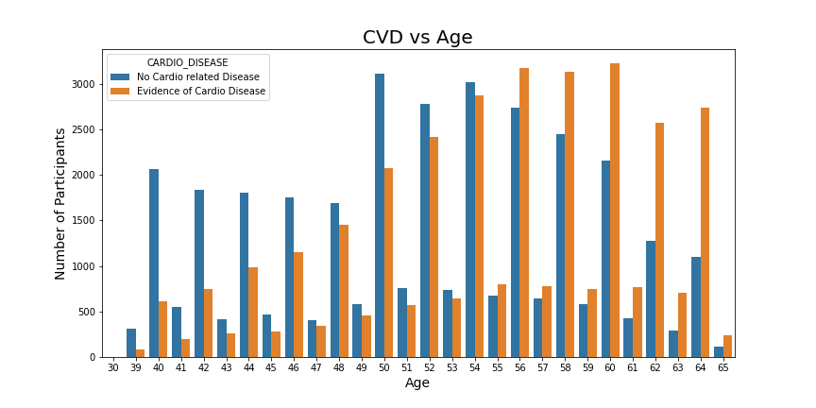
Data Analysis
Notes:
Divya

Slide 16
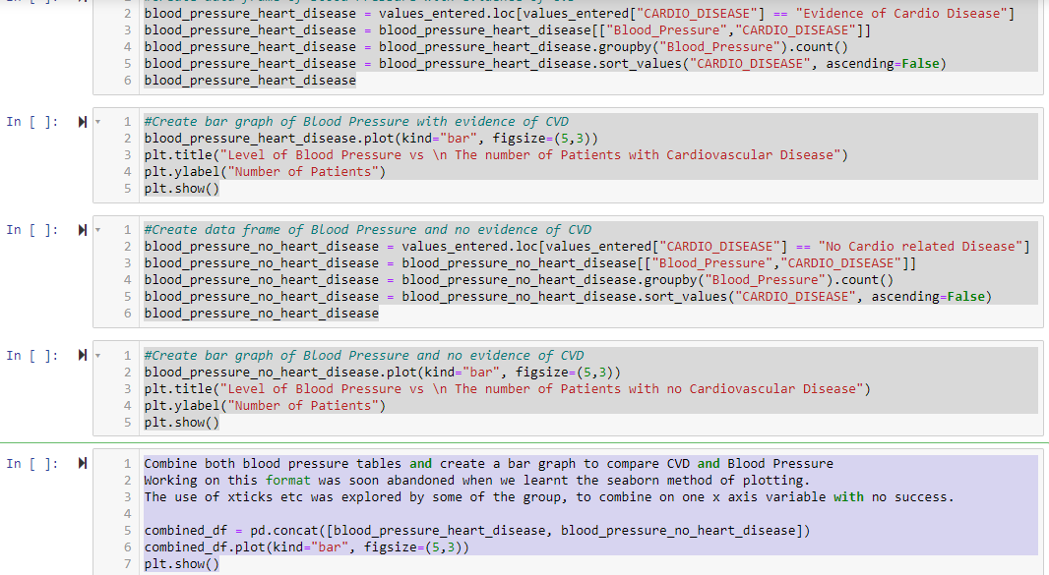
Data Analysis: First attempt at bar graphs with pandas.
Notes:
Divya

Slide 17
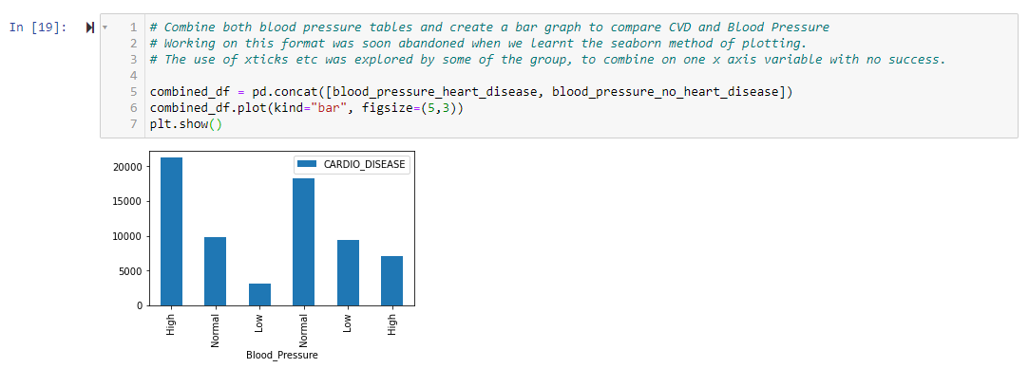
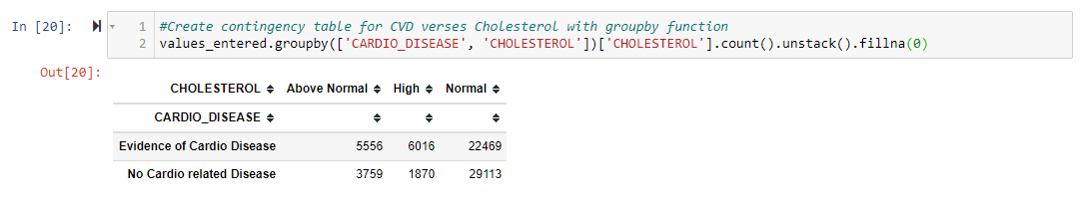
Data Analysis: First attempt at bar graphs with pandas. Cross Table using Groupby function in pandas
Notes:
Divya

Slide 18
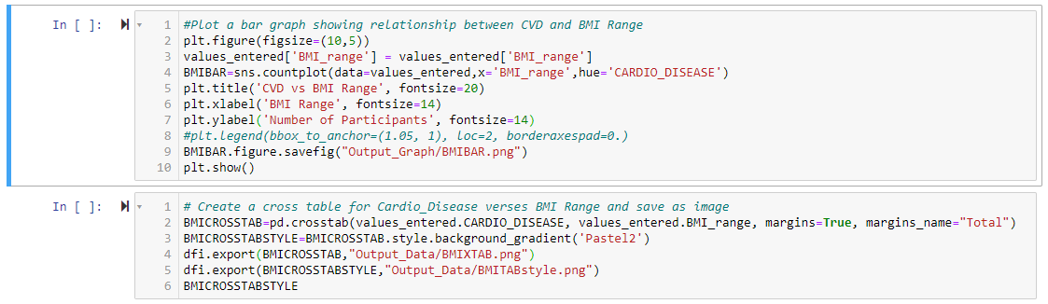
Data Analysis: Bar graphs through seaborn that worked and pandas crosstabs with totals
Notes:
Divya

Slide 19
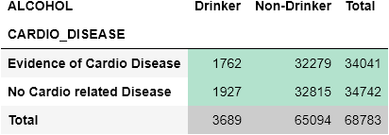
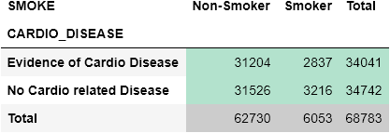
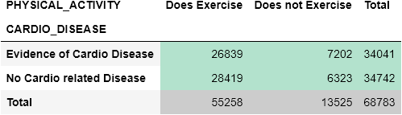
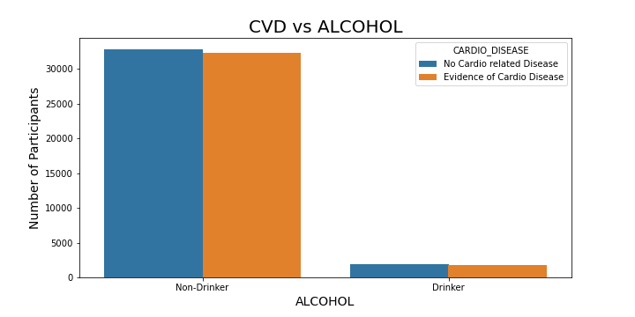
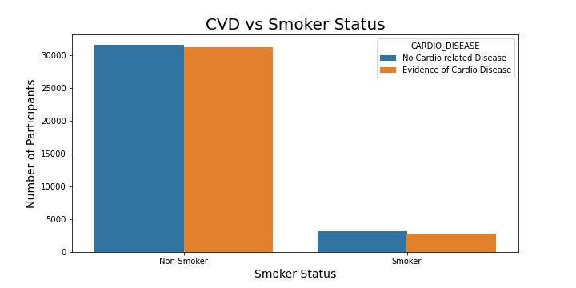
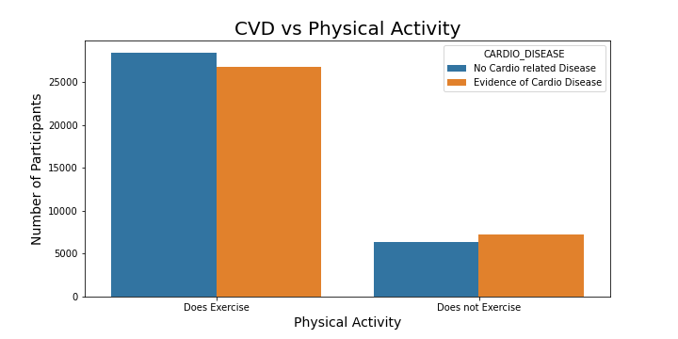
Data Analysis
Notes:
Divya

Slide 20
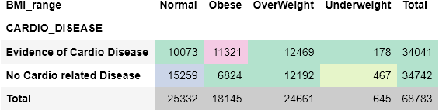
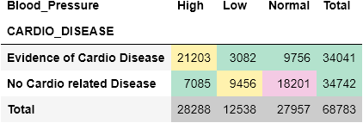
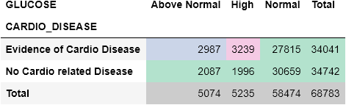
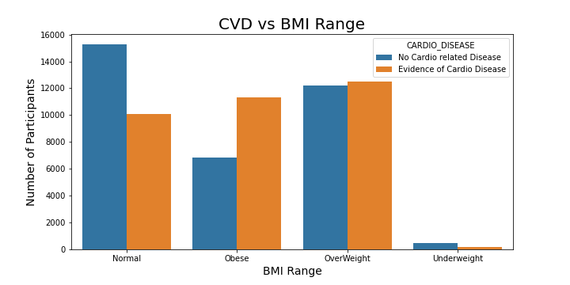
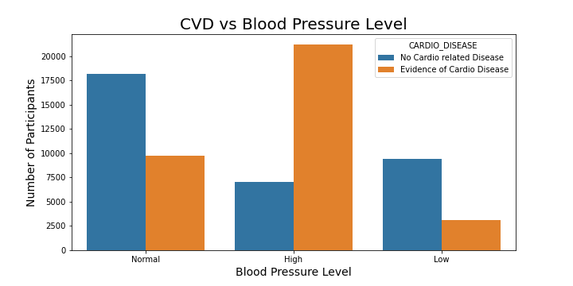
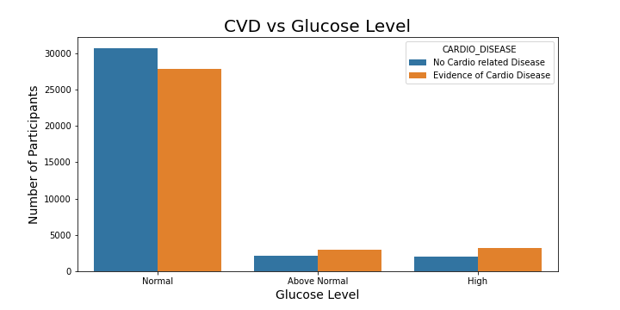
Data Analysis
Notes:
Divya

Slide 21
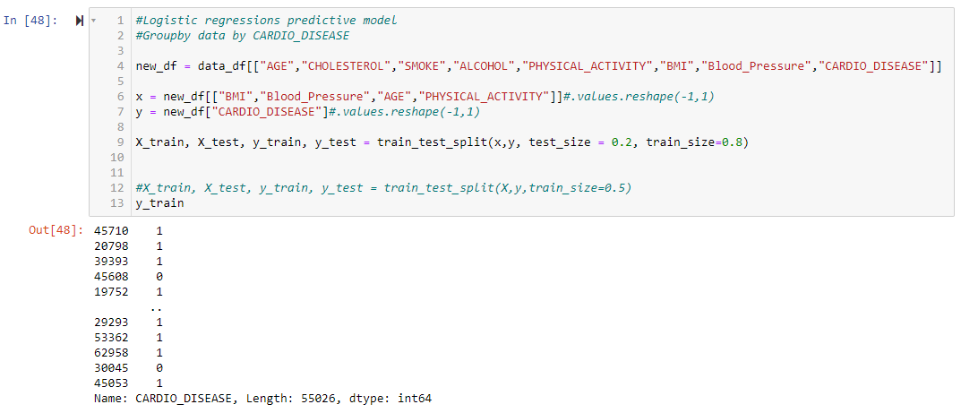
Data Analysis: Predictive model
Notes:
Divya

Slide 22
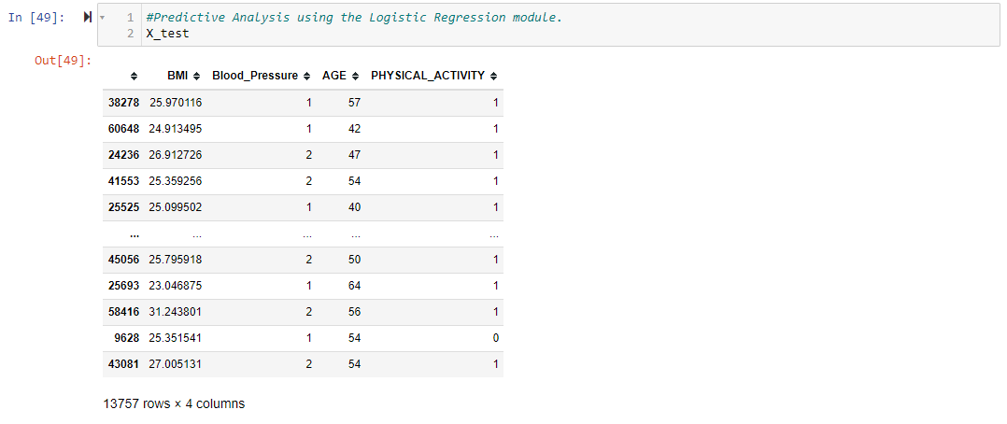
Data Analysis: Predictive model
Notes:
Divya

Slide 23
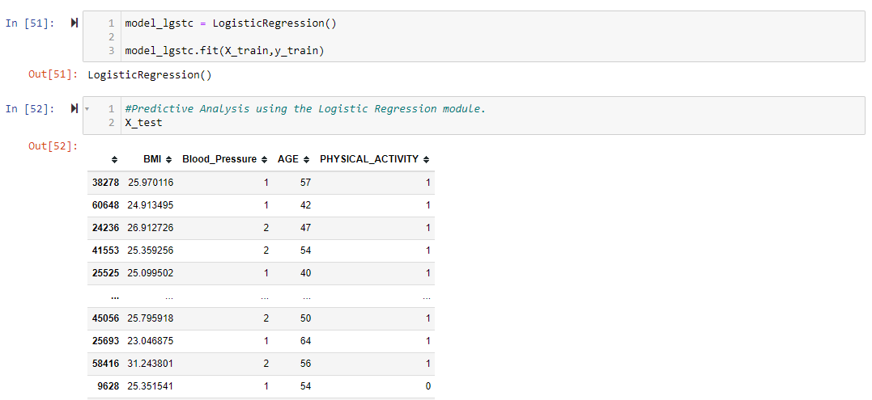
Data Analysis: Predictive model
Notes:
Divya

Slide 24
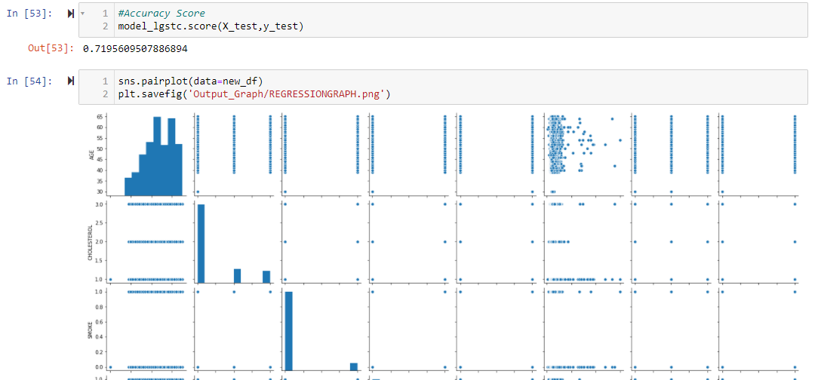
Data Analysis: Predictive model
Notes:
Divya

Slide 25
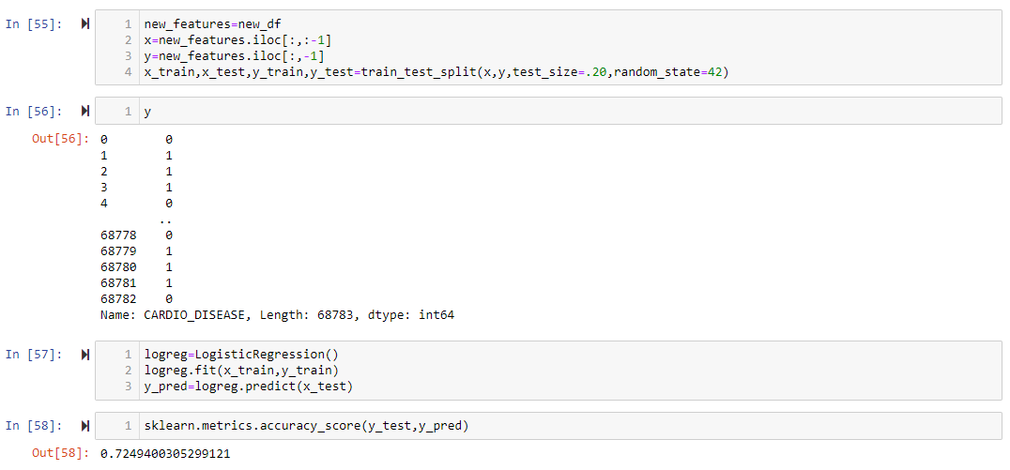
Data Analysis: Predictive model
Notes:
Divya

Slide 26
Post Mortem
Conclusion
In our analysis we found:
Gender was not a contributing factor to CVD
As Age progresses the chance of CVD increases (especially after age 55)
High Cholesterol levels indicate an increased chance of CVD.
Blood Pressure levels above 120 had a direct correlation with CVD.
Patients with a BMI index of Overweight and Obese have a higher chance of CVD.
Patients who exercise are less likely to contract CVD in comparison to those who do not exercise.
Predictive analysis, using logistic regression model we were able to have an accuracy level of 72%
Limitations:
Missing variables contributing to CVD: Nutrition, dietary, location, socio-economic factors.
Unable to present more variety of visualizations due to categorical data.
Notes:
Steve

Slide 27

Questions
Open-floor Q&A with the audience

